Slide 1
Linux Utilities

Slide 2
We’ll be going over…
Clamav
Gufw
Man pages
Tiger
Lynus
Text editors

Slide 3
Clamav (anti-virus)
Installation/Setup
sudo apt-get update
sudo apt-get install clamav clamav-daemon
sudo freshclam
Basic Usage
clamscan --infected --remove --recursive /
--infected: print infected files
--remove: remove infected files
--recursive: scan subdirectories of given folder
Warning
If output is “killed”, increase memory for VM

Slide 4
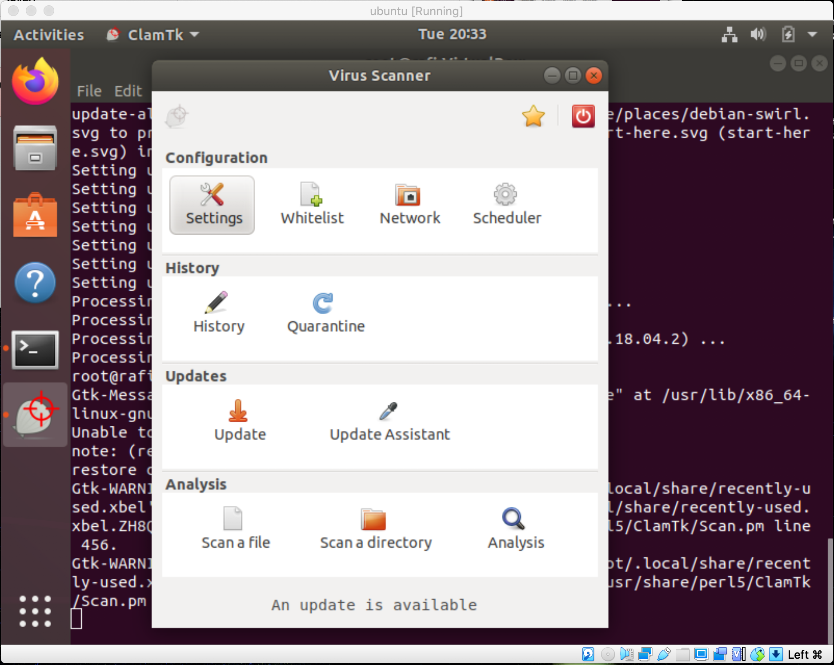
Clamav GUI - Clamtk
Installation/Setup
sudo apt-get install clamtk

Slide 5
Man pages (manual pages)
Documentation manual for commands
Useful for understanding command arguments
Default opens in vim
Usage
man clamscan
Exit: :q

Slide 6
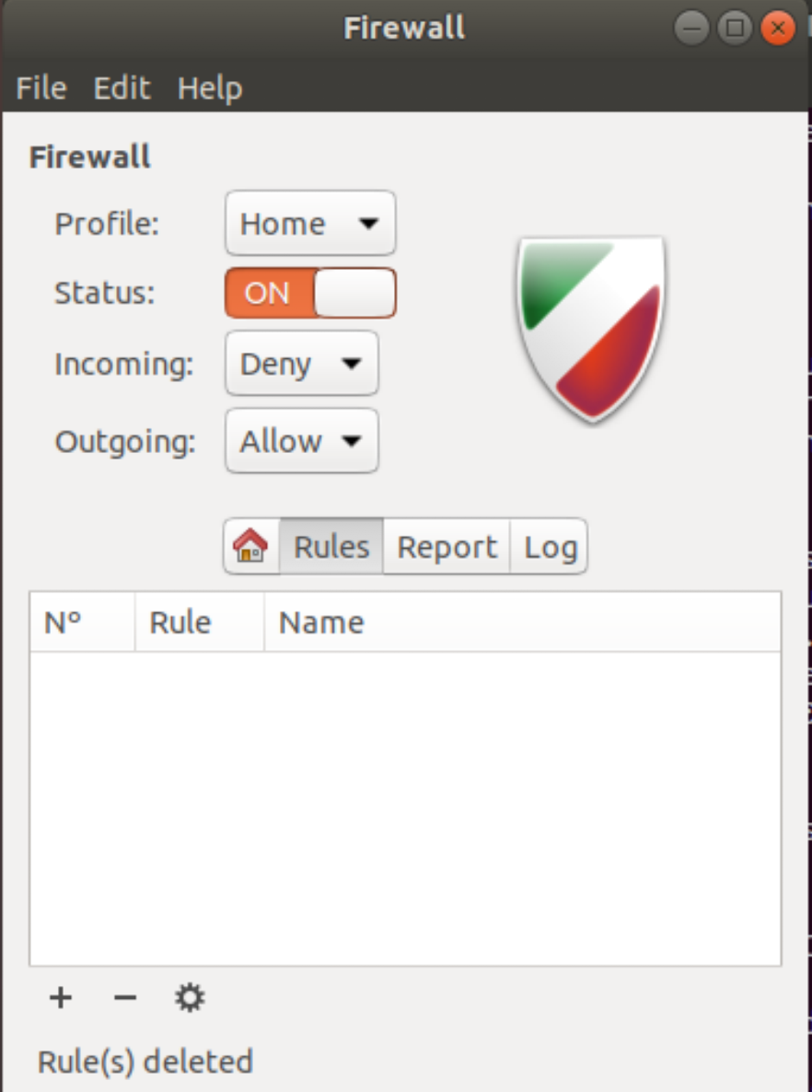
GUFW
Firewall GUI (UFW - uncomplicated firewall)
Installation
sudo apt-get install gufw
Usage:
Gufw

Slide 7
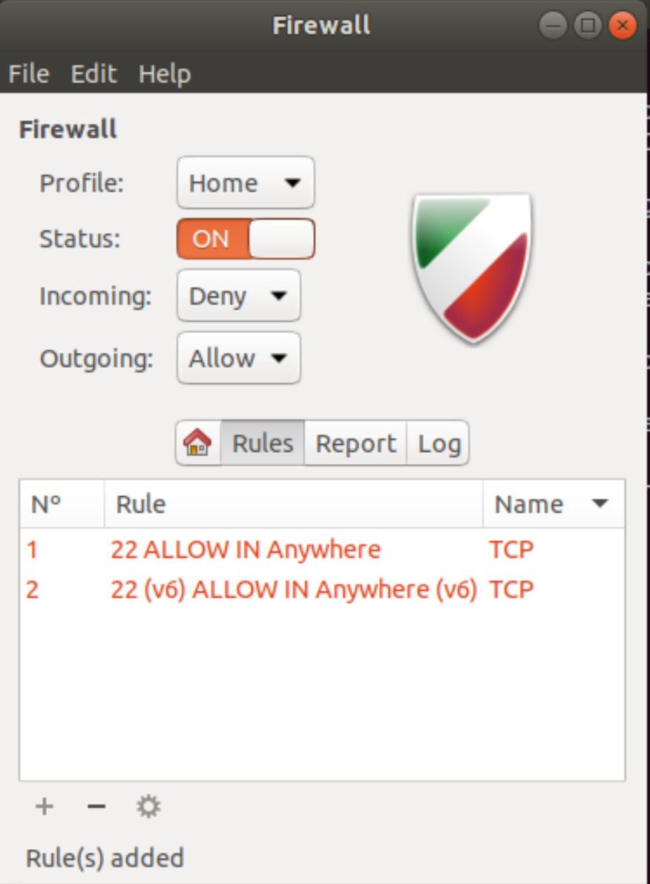
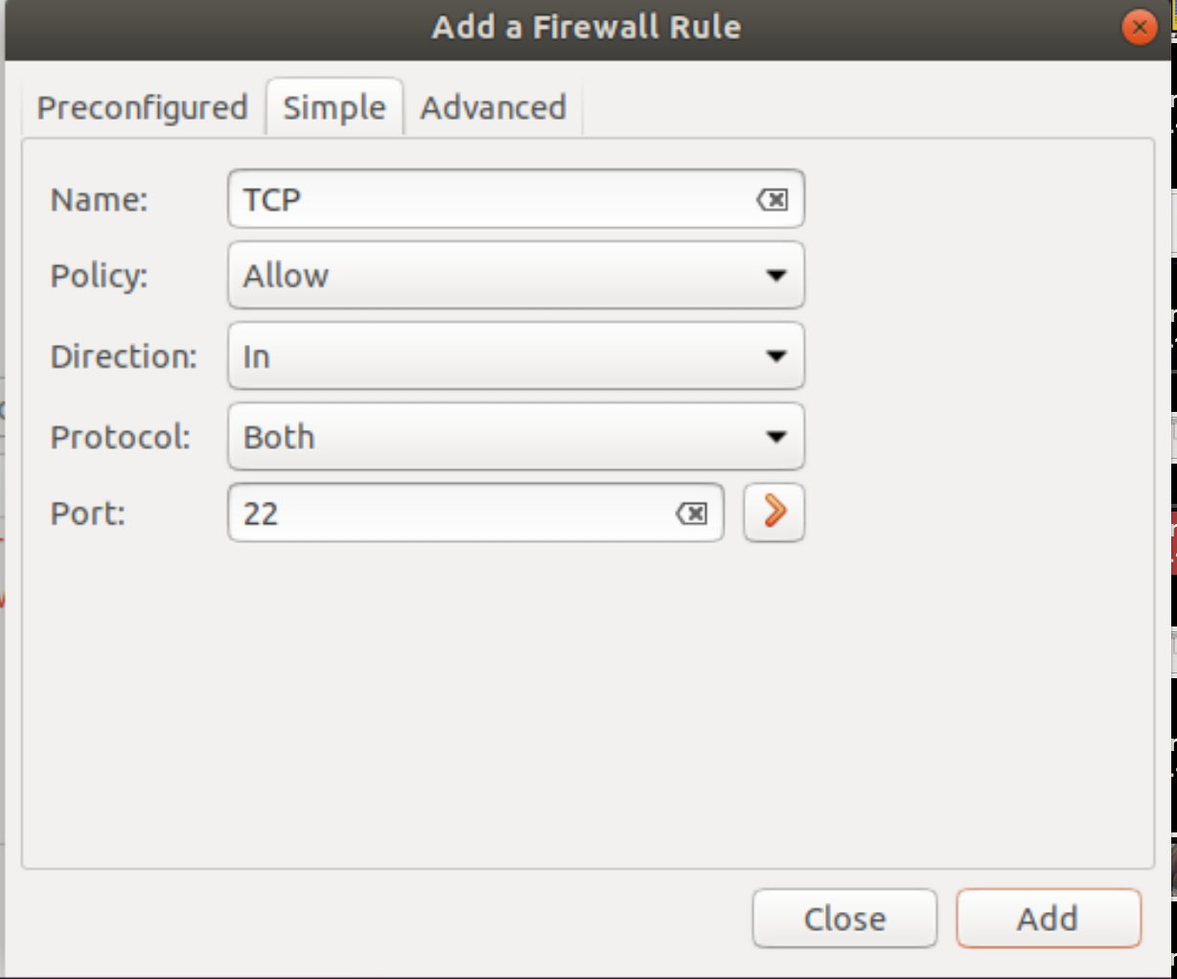
GUFW - Rules

Slide 8
Ranger
File manager through the terminal
Installation
sudo apt install ranger
Usage
Ranger
Use arrow keys:
=>: enter directory
<=: go to parent
^: go up
↓ : go down
q: exit

Slide 9
Tiger
Generates report on audit info and intrusion detection
Somewhat old (hasn’t been updated from 2018)
Installation
sudo apt install tiger
Usage
sudo tiger
sudo tiger -E
Produces log file with warnings, gives warning path at the end of output
cat <path-to-log-file>

Slide 10
Lynis
Generates report on Auditing info/security vulnerabilities
Installation
Sudo apt install lynis
Basic Usage
lynis audit system
GREEN: good
Yellow: Not found or just a suggestion
RED: possible vul
lynis show details test-id
Get more information about the suggestions/warnings offered at end of the output

Slide 11
Text Editors
Gedit
Pros: simple interface
Cons: Very few features
Nano
Pros: somewhat simple interface, more keyboard commands than gedit
Cons: not many commands
Vim
Pros: Large variety of keyboard commands, color-coded
Cheat sheet: https://vim.rtorr.com/
Cons: Very difficult at first
*Both Vim and Nano open directly in terminal

Slide 12
Basic Nano commands
Normal:
Arrow keys
w - next word
b - prev word
{ - next blank line
} - previous blank line
d - delete
dd - delete current line
v - select text
y - copy
p - paste
d - delete
u - undo
r + ctrl - redo
/ - search forward for pattern
? - search backward
:wq - save and exit

